Slide 1
Excellent Company
2 users, 2 interns
user1, user2, intern1,intern2

Slide 2
Some things you need to know….
After working down through the requirements, I found a couple of errors and I corrected them on the way in creating this Powerpoint, so please see the corrections. Thanks.

Slide 3
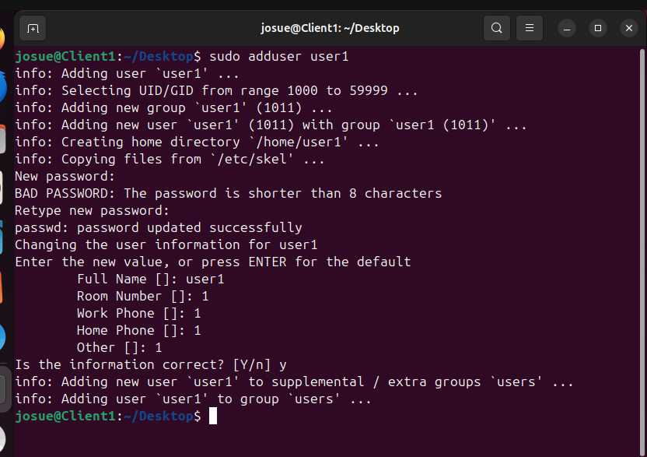
Sudo adduser user1, user2, intern1,intern2
user1

Slide 4
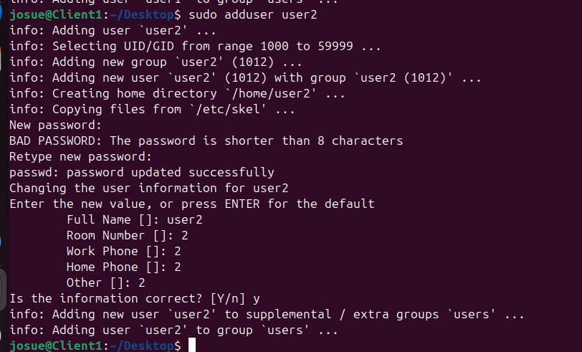
user2

Slide 5
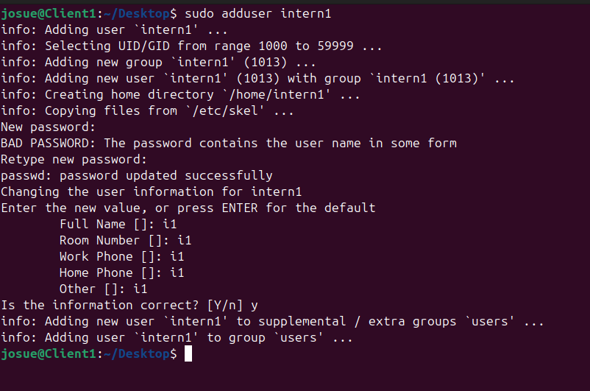
intern1

Slide 6
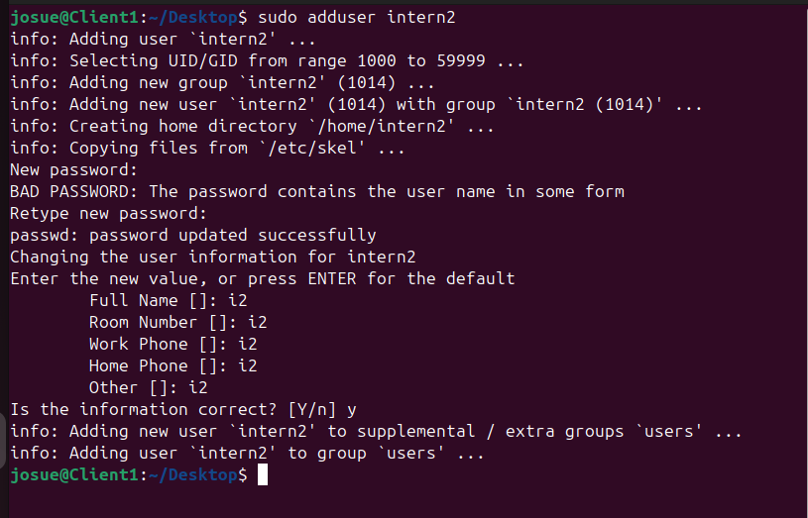
intern2

Slide 7
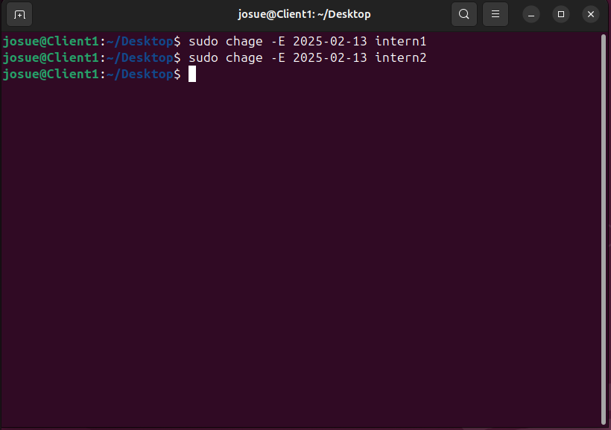
6 Month Account Durations intern1,2
chage -E {yyyy-mm-dd} {user name}

Slide 8
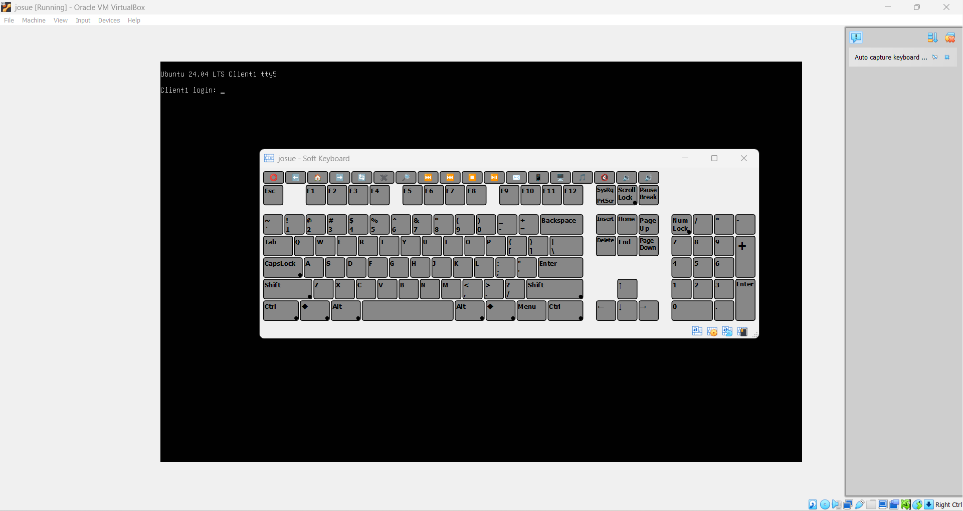
Configuring New User Accounts user1, user2, intern1, intern2
Using softkeyboard alt+ctrl+f5

Slide 9
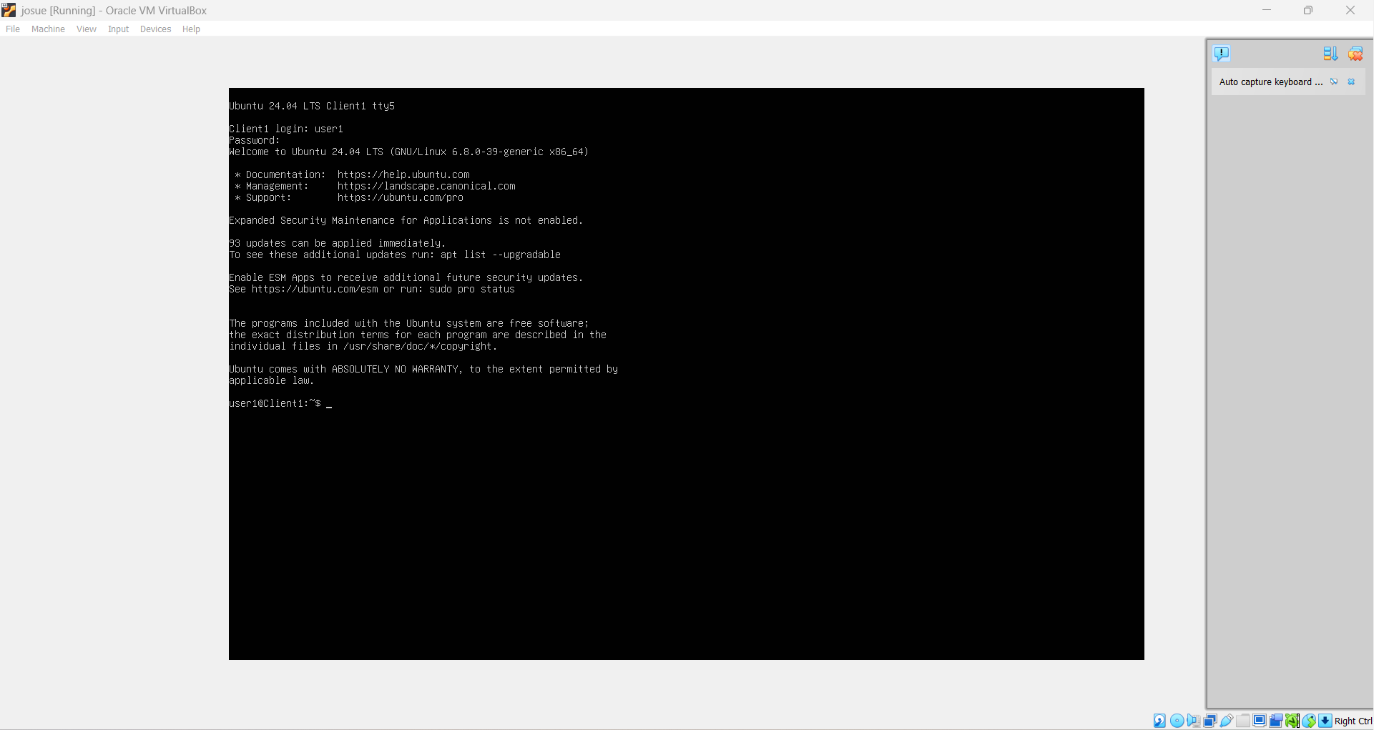
Login as user1 and configure Review Default Home Directory

Slide 10
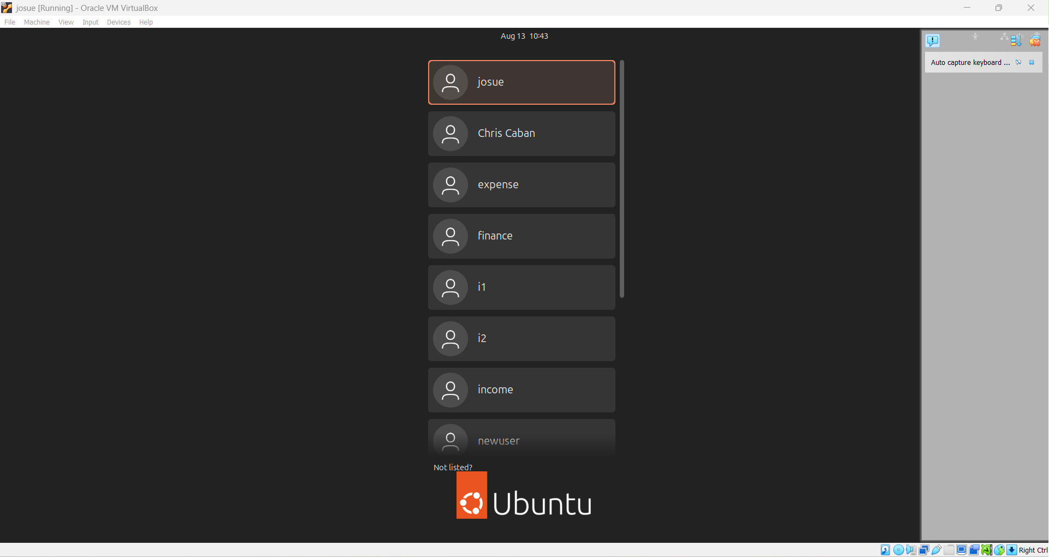
Logout, alt+ctrl+f1 for client 1 then, open terminal

Slide 11
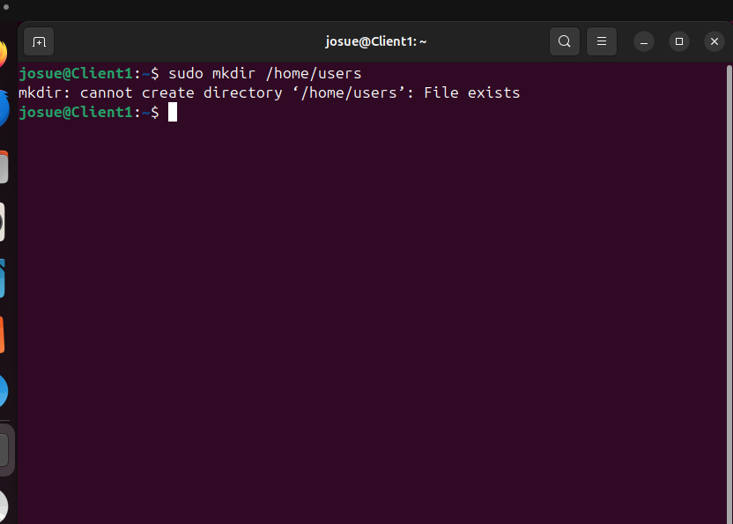
Creating a parent directory to host the new home directories.
So…this was already created during the course but want to demonstrate the commands to do this.

Slide 12
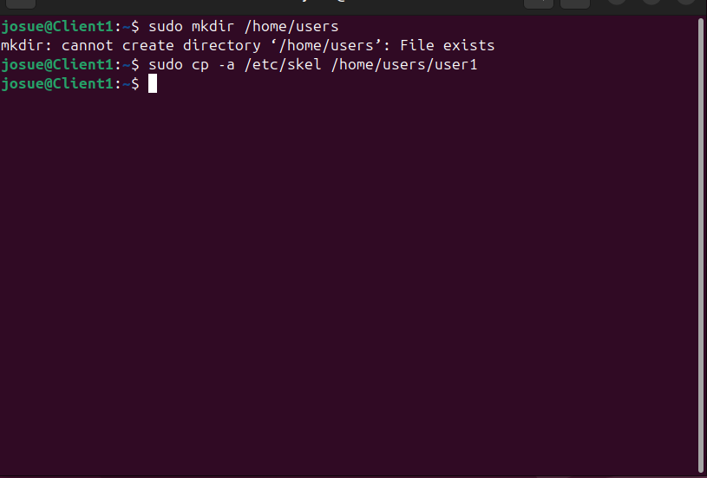
Creating a new home directory with the contents of the /etc/skel directory user1

Slide 13
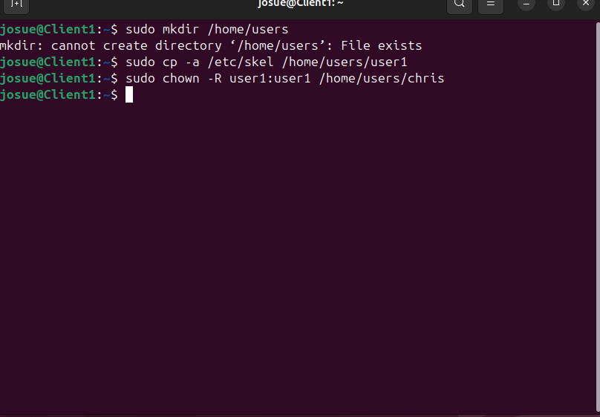
Changing ownership for user1 so the ownership can be transferred to user1

Slide 14
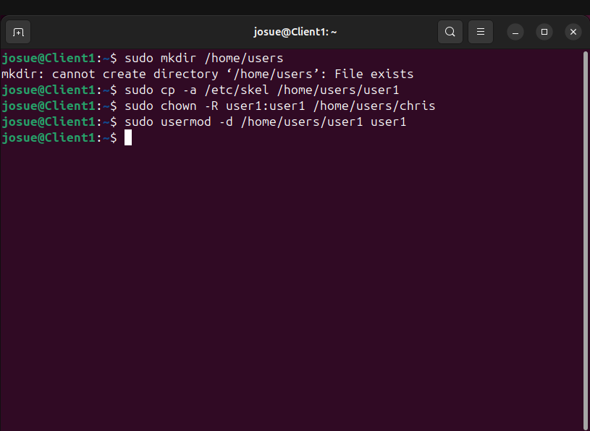
Assigning the new directory to the user1 account as the home directory.

Slide 15
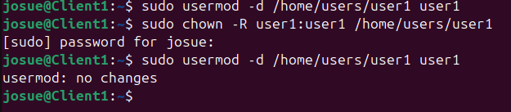
Made an error using chris account, corrected command syntax for user1, mod was already done

Slide 16
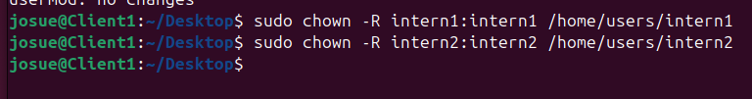
Update: I found out later while changing directories that the ownership change did not take, I redid them for user2, intern1,intern2

Slide 17
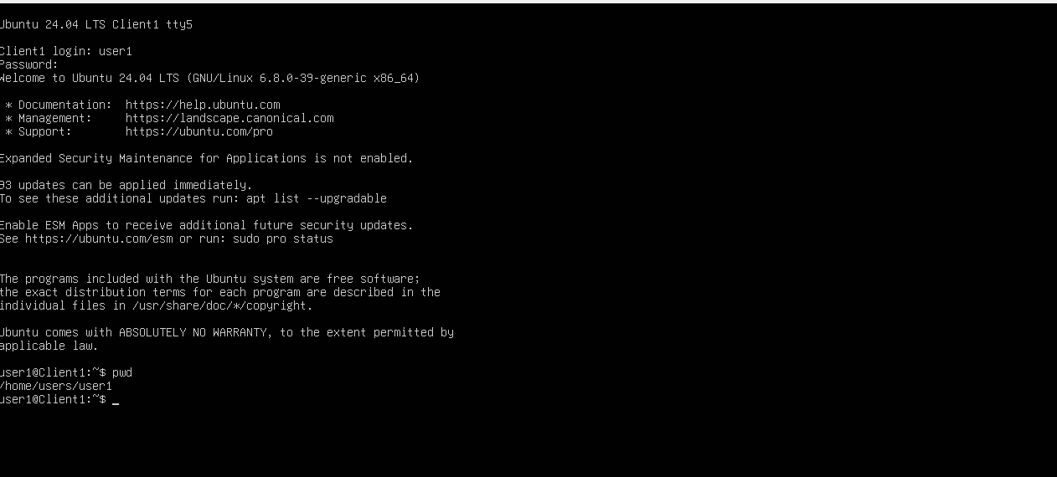
Test the changes. Using the Soft Keyboard, send the Ctrl+Alt+F5 command. Log in as user1, pwd to show current working directory

Slide 18
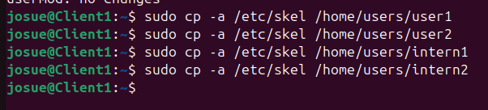
Continued configuring New User Accounts user2, intern1, intern2

Slide 19
Changing ownership user2, interns1,2

Slide 20
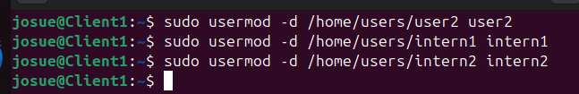
Assigning the new directory for user2, intern1,intern2

Slide 21



Test the changes. Using the Soft Keyboard, send the Ctrl+Alt+F5 command. Log in as user2, intern1, intern2, pwd to show current working directory

Slide 22
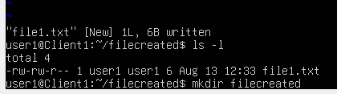


Demonstrating make directory mkdir and file creations VIM for user1, user2, intern1, intern2
user1@Client1: mkdir filecreated (unfortunately cache hung up).
cd~/filecreated
vim file1.txt

Slide 23
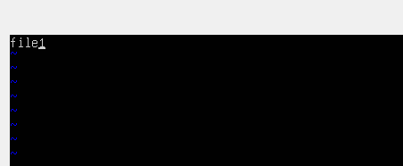

Demonstration continued…
Added txt file1 in vi editor
Hit esq, then :wq write, quit.

Slide 24

Demonstration continued…
ls-l to show file1.txt
Logged out as user1, logged in as user2, intern1, intern2, make directories as filecreated in all, named in vim file 2,3,4 in each directory.

Slide 25



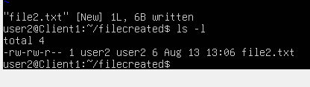

user2
mkdir
cd ~filecreated
vim file2.txt, used o, posted file2, esq, :wq. ls –l to verify.

Slide 26





intern1
mkdir
cd ~filecreated
vim file2.txt, used o, posted file2, esq, :wq. ls –l to verify.

Slide 27
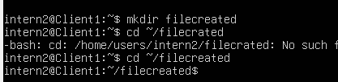



intern2
mkdir
cd ~filecreated
vim file2.txt, used o, posted file2, esq, :wq. ls –l to verify.

Slide 28
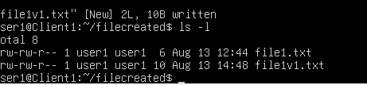
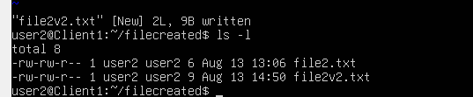
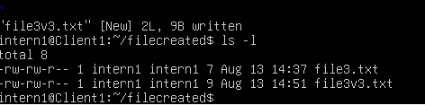

Created two files in each directory user1, user2, intern1, intern2 per capstone guide

Slide 29
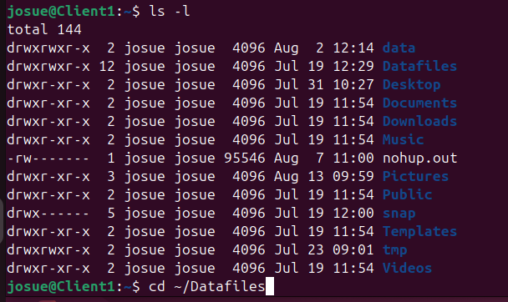
Setting permissions
Reviewing list using ls –l

Slide 30
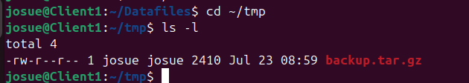
Change Directory to tmp, posting chmod
cd ~/tmp
ls –l
chmod –v u=rw,g=,o= backup.tar.gz
Restored:

Slide 31

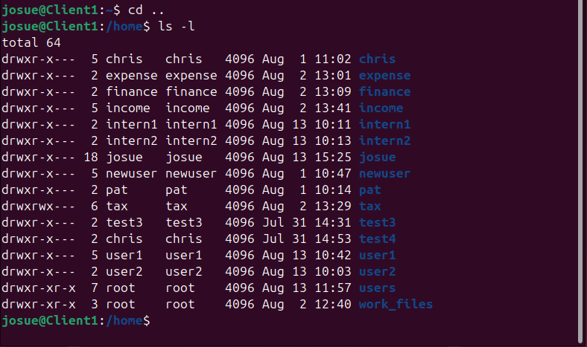
Immutable Flag /home/tax/finance
None are listed by using command lsattr /home/tax
Change directory to cd ~/home, then did a ls –l

Slide 32
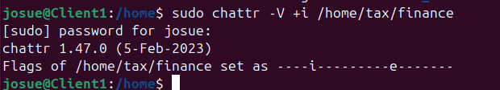
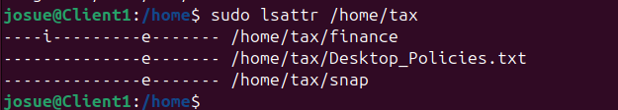
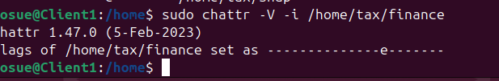
Set, Remove Immutable Flag for Finance
sudo chattr -V +i /home/tax/finance
Verified immutable set
Removed immutable

Slide 33
Create a text file that has all the commands needed to perform the backup you designed.
Not sure what Shad was asking whether to do a VIM file to create a back up, which I would not know where to start. I would need a template to review, just could not find it.
All I found was this for rsyslog.conf.
To open the /etc/rsyslog.conf file, type sudo vi /etc/rsyslog.conf and press Enter.
Navigate to the line containing #module(load=imtcp) and position the cursor at the beginning of the line.
Remove the # hash character on this line and the following line to set it as module(load=”imtcp”) and input(type=”imtcp” port=”514).
To save and close the file, press Esc. Type :wq and press Enter.
To restart the rsyslogd service, type sudo systemctl restart rsyslog.service and press Enter

